Slide 1
SIXTribution
Team: Pavel Jahoda, Daniel Gillo, Žan Stanonik, Zuzana Urbanová

Slide 2
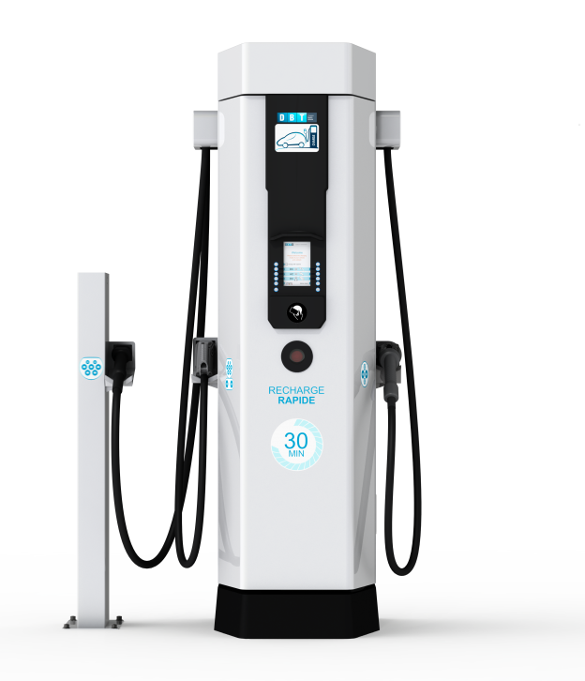



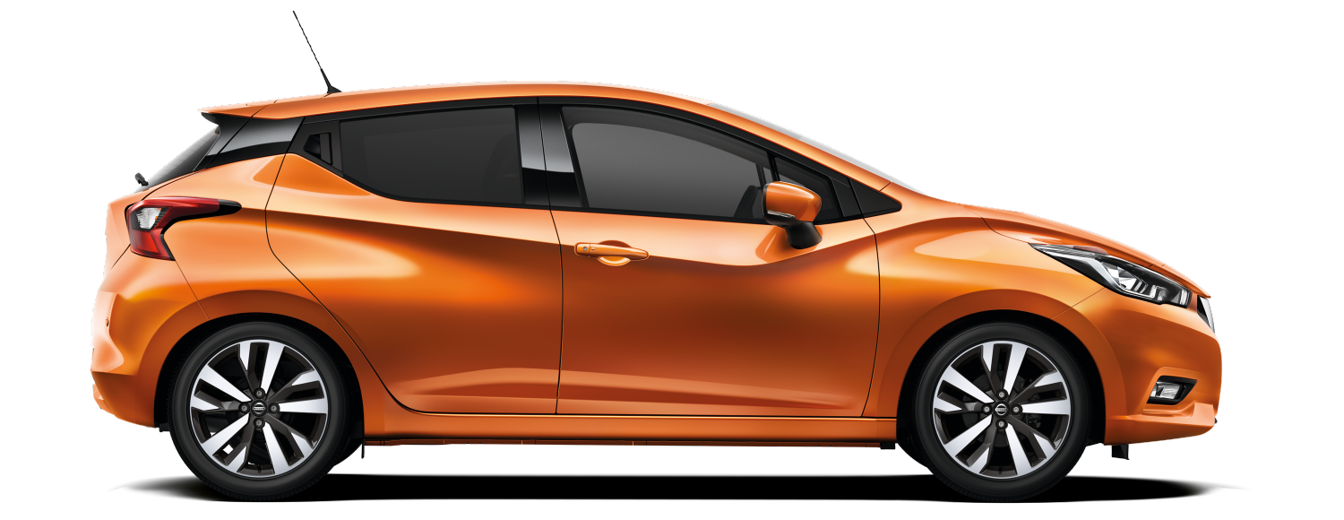
Problem Overview
Few charging stations
Growing electric car fleet

Slide 3
Solution
Optional drop-off at public charging stations
Algorithmically decide alternate/best charging destinations based on supply/demand
Give reward offer notifications to the customer to leave the car where we want
Sixt drivers use the car for Sixt ride

Slide 4
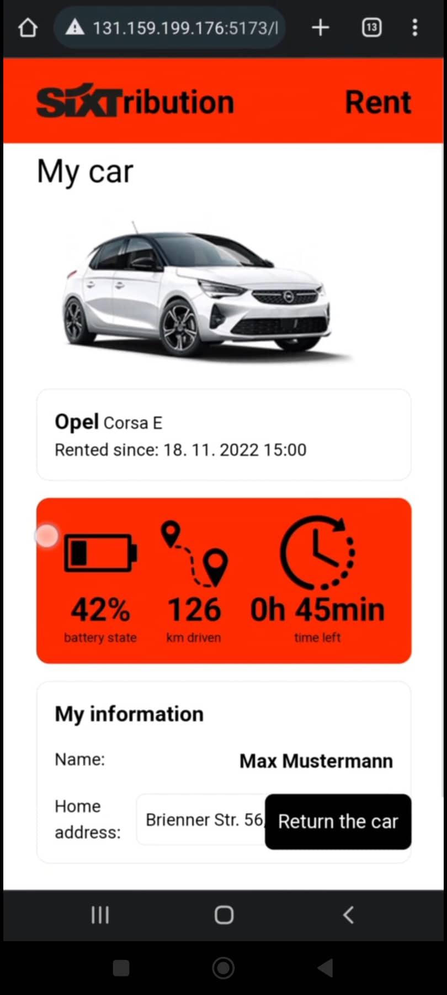
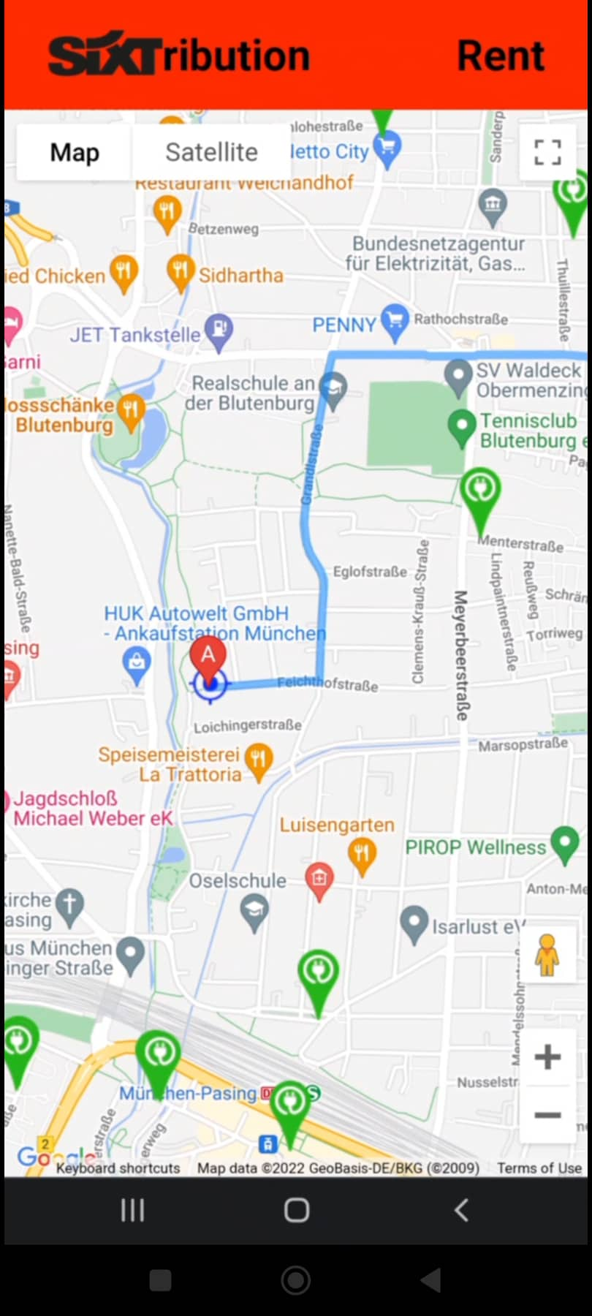
Our system
Full-scale simulation of Munich
Charging Stations data (data from OSM & SWM maps)
A fully simulated fleet based on the cars in the Sixt API
Simulation integrated into web application
Stack: Python, Vue.js, Google Maps API

Slide 5
Live demo!

Slide 7

Thank you for listening ❤

Slide 8

Jump in! We’re heading to FUNtimes

Slide 9
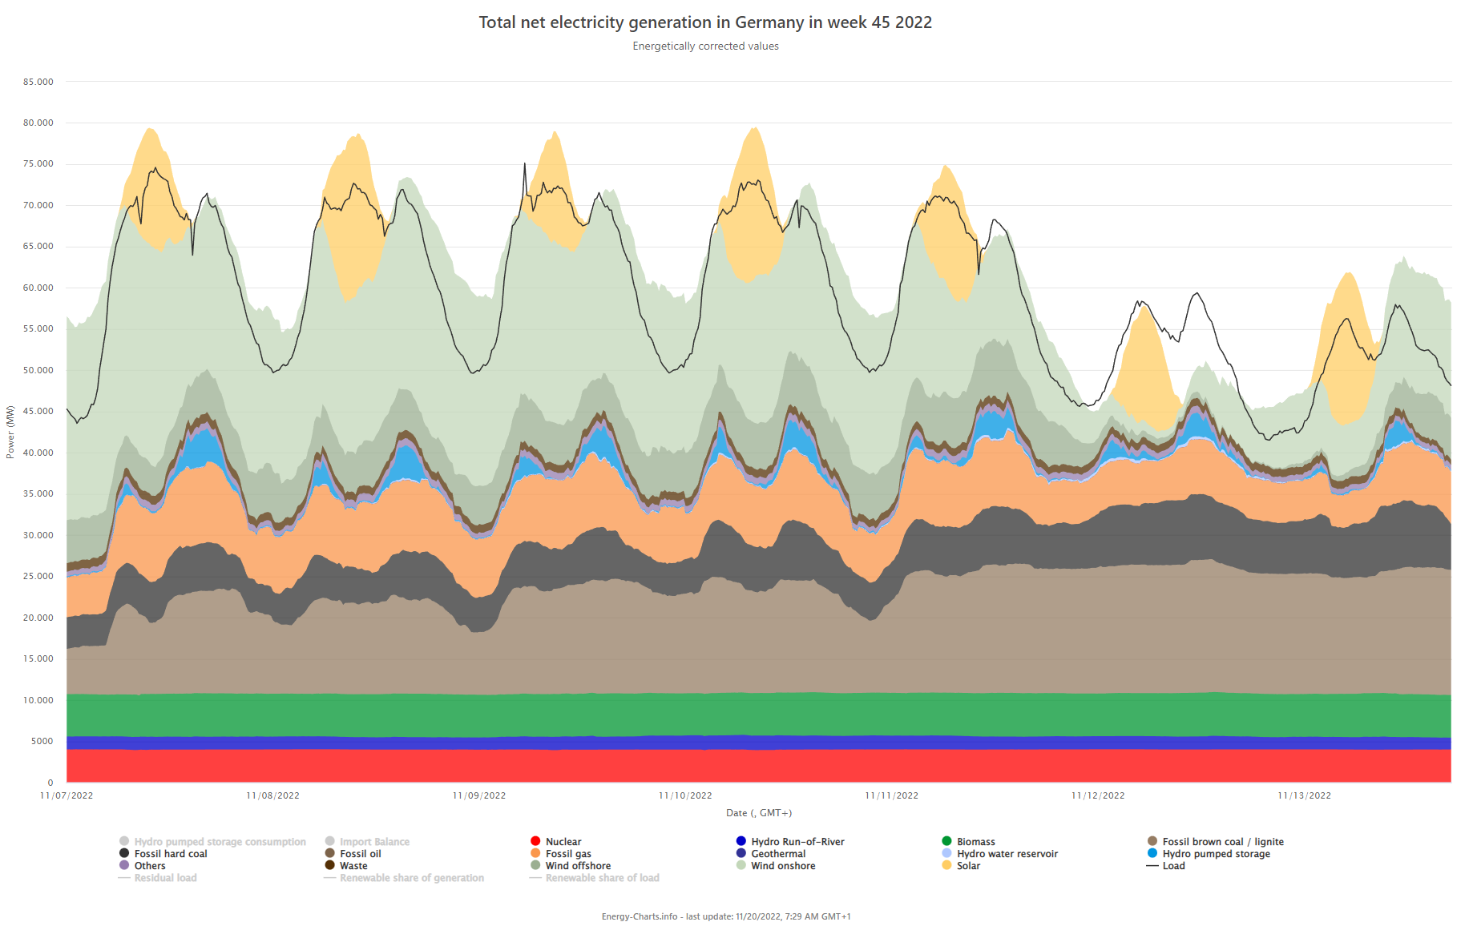
Future improvements
With surge pricing, we could decide when to charge the vehicles while in storage to get cheaper prices while there is lower usage. (eg charge overnight or during peak afternoon)
https://energy-charts.info/charts/power/chart.htm?l=en&c=DE&stacking=stacked_absolute_area&week=45&source=total

